Slide 1

FNP Sales Analysis
A comprehensive sales analysis for Ferns and Petals (FNP), a leading online gifting service specializing in various occasions such as Diwali, Raksha Bandhan, Holi, Valentine's Day, Birthdays, and Anniversaries. The aim was to uncover key insights from the sales data, identify trends, and provide actionable recommendations to help the company improve its sales strategy and optimize customer satisfaction and enhance business performance.

Slide 2
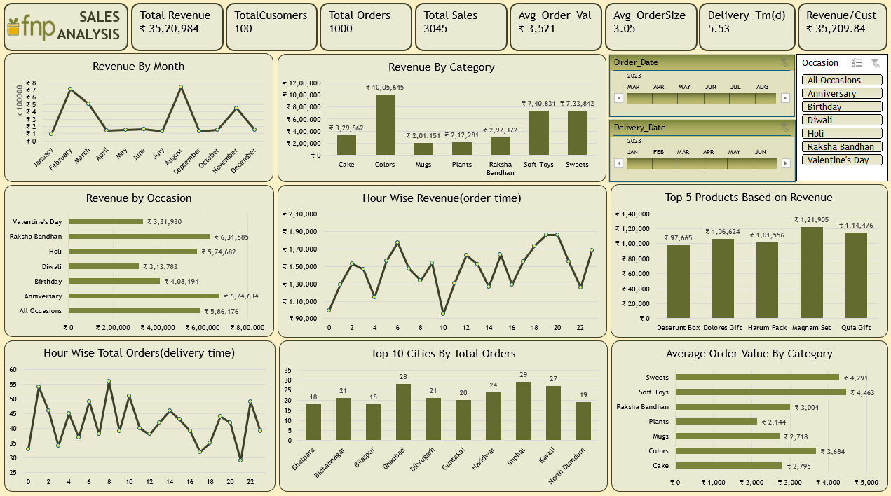
DASHBOARD

Slide 3
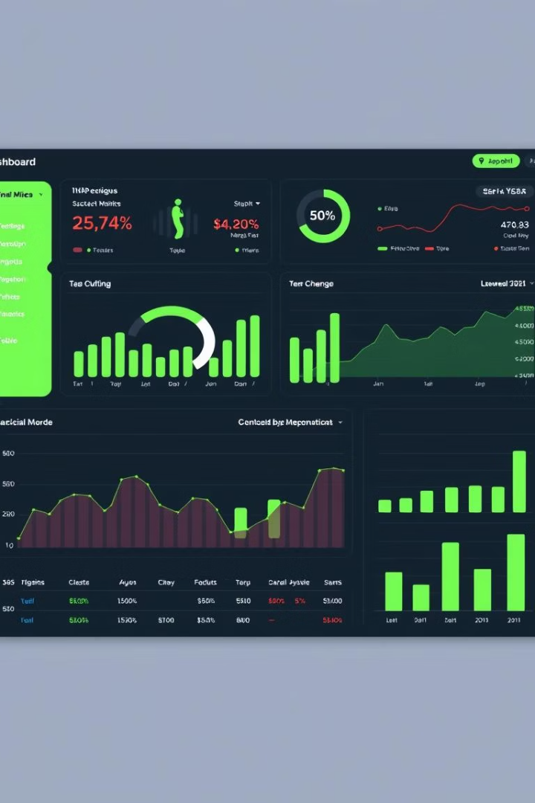
Key Financial Metrics
₹35,20,984
5.53
Total Revenue
Avg. Delivery Time
Overall sales performance
Days from order to delivery
₹35,209
Avg. Customer Spend
Per customer transaction value

Slide 4
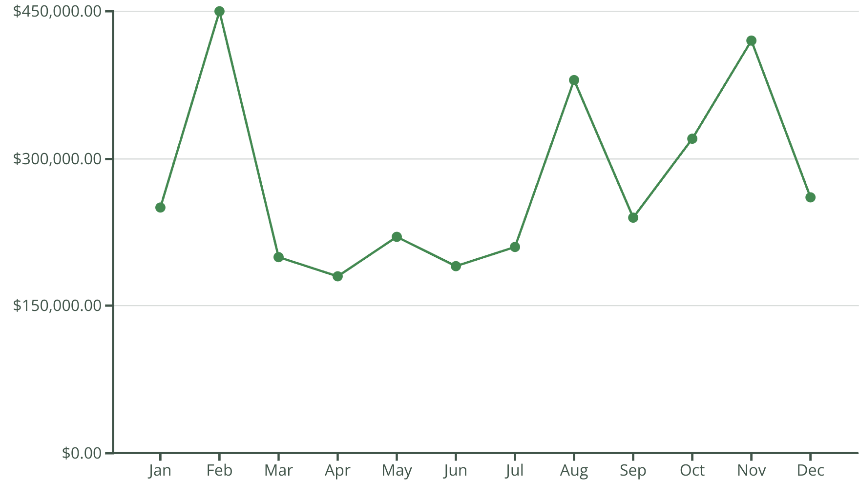
Monthly Revenue Trends

Slide 5





Top Revenue Generating Products
Deserunt Box
Premium gift option with highest sales volume
Dolores Gift
Popular choice for anniversaries
Harum Pack
Bestseller during festival seasons
Magnam Set & Quia Gift
Strong performers across multiple occasions

Slide 6










Revenue by Occasion
Diwali
Raksha Bandhan
Strong festival performance
Birthdays
Second highest revenue
Consistent year-round revenue
Valentine's Day
Anniversaries
Highest revenue generator
Significant contribution to sales

Slide 7
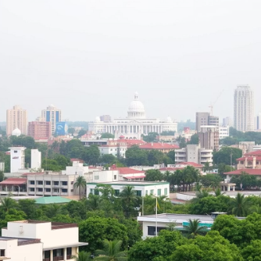
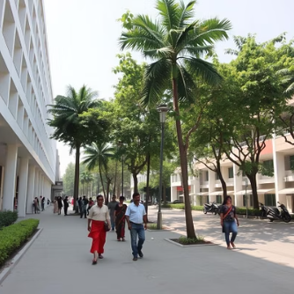



Top Cities by Order Volume
Northern Region
Eastern Region
Central India
Haridwar leads with highest order density
Bhatpara, Bidhannagar, and North Dumdum show strong performance
Bilaspur and Dhanbad represent key markets

Slide 8





Time-Based Sales Patterns
Morning
Evening
Moderate order volume (8AM-12PM)
Peak revenue hours (5PM-9PM)
Afternoon
Night
Steady increase in orders (12PM-5PM)
Gradual decline in orders (9PM-12AM)

Slide 9





Recommended Strategies
Targeted Marketing
Focus on peak hours and high-volume cities
Delivery Optimization
Reduce average delivery time from 5.53 days
UX Improvements
Enhance website and app experience
Social Media Engagement
Partner with influencers for wider reach

Slide 10

Continuous Improvement Framework
Data Analysis
Regular monitoring of sales trends and customer preferences
Brand Investment
Strengthen identity as premier gift provider
Competitor Monitoring
Stay ahead of market developments
Customer Feedback
Implement robust review system

Slide 11
Thank You
If you are hiring or know someone who is – Let’s Connect !

